Slide 1
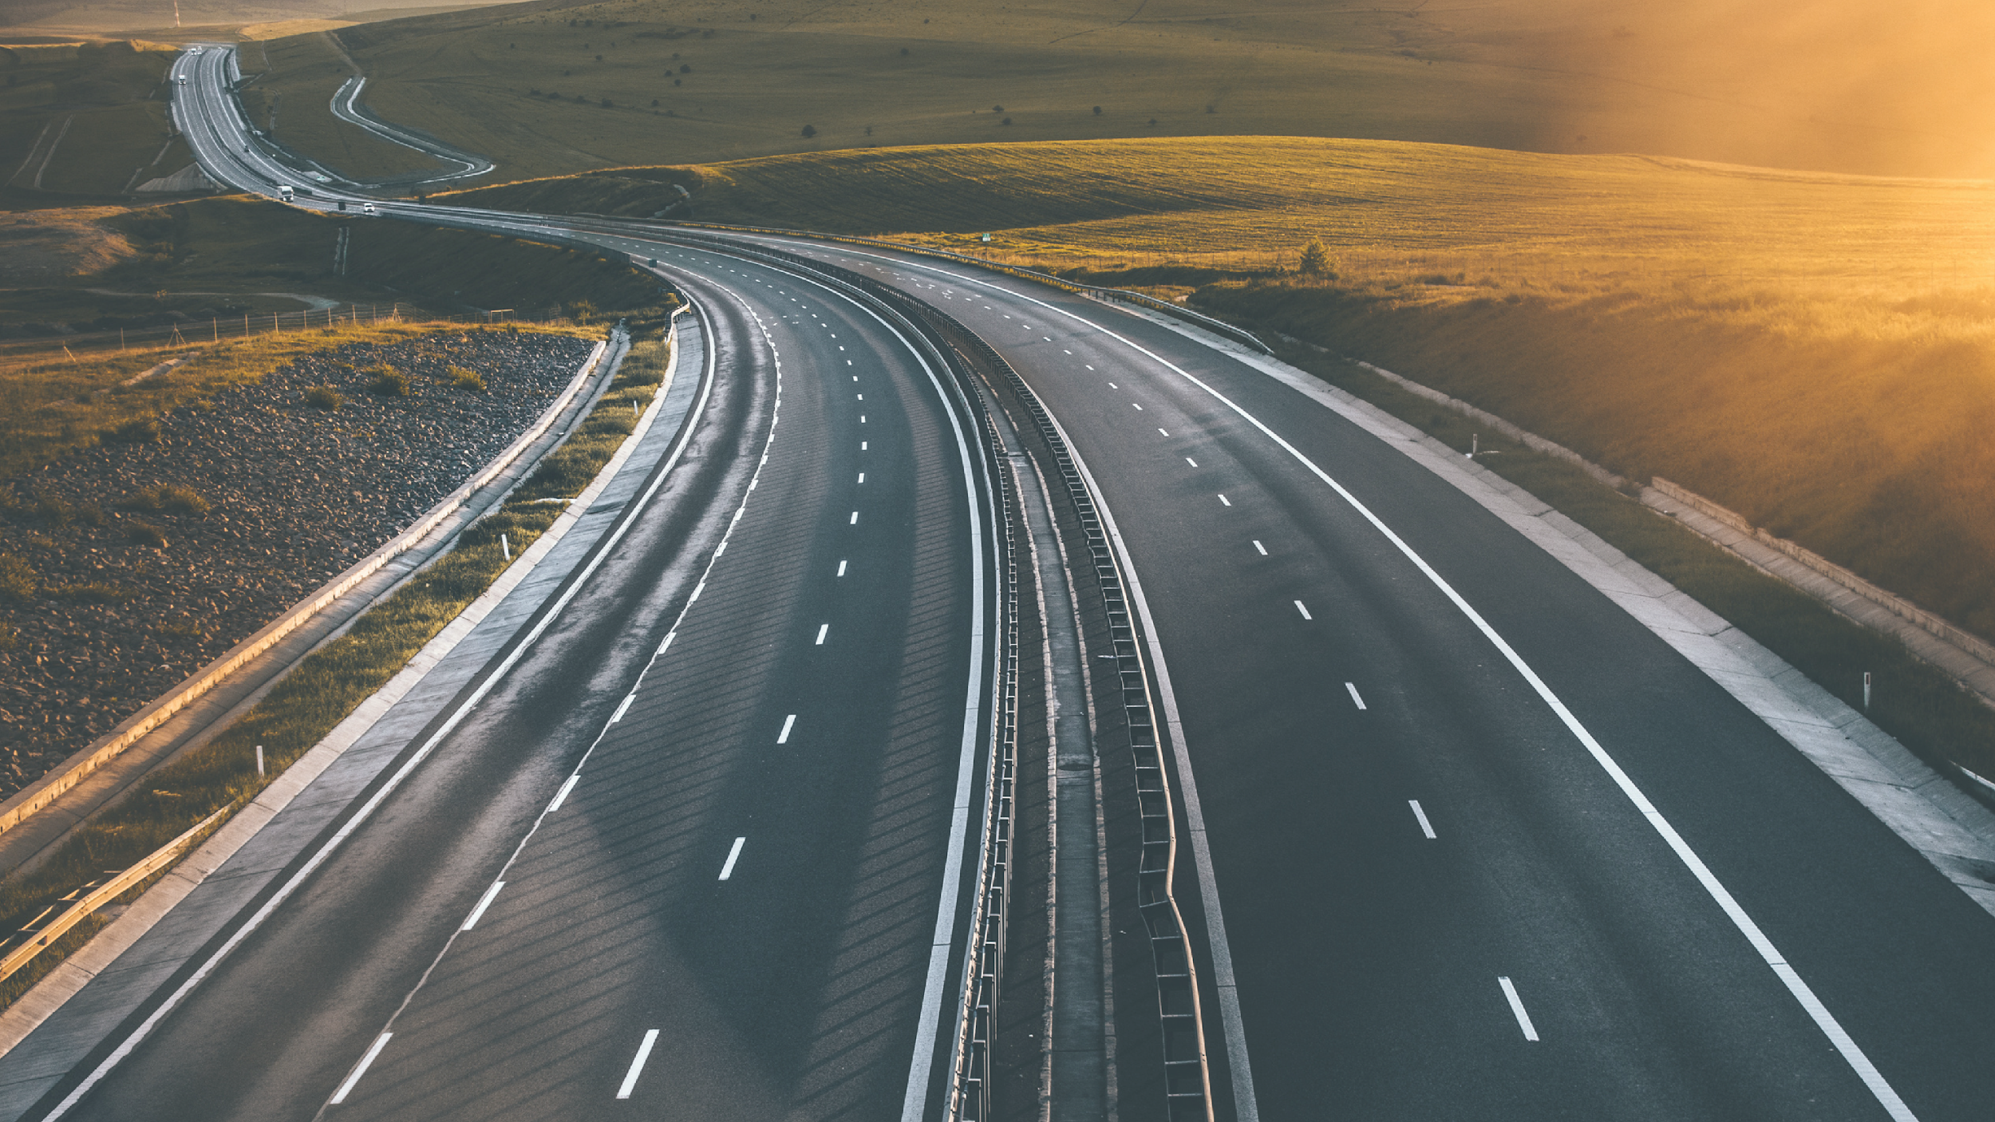
Image Identification for Self-Driving Cars

Slide 3
SAFETY

Slide 4
SIMPLE

Slide 5
Work Distribution Chart
Yolo Model: 王子瑋, 翁雨暘
GUI: 王子瑋, 翁雨暘
Traffic Light Classification: 王子瑋, 翁雨暘
Traffic Sign Classification (Machine Learning): 楊雁萍, 羅英期
Traffic Sign Classification (Deep Learning): 羅英期, 楊宗翰, 張惠晴, 簡匡甫
Dataset Collection and label (Yolo): 羅英期, 楊宗翰, 張惠晴, 簡匡甫

Slide 6
Outline

Slide 7
Outline
Motivation
09
Flowchart
11
Gui - TKinter
13
Object detection
18
Traffic Light Classification
28
Traffic Sign Classification
32

Slide 8
Motivation

Slide 9
1. Among the flourishing development of self-driving car technology, 2D images recognition for identifying objects such as cars, pedestrians, traffic lights, etc., is one of the techniques that attract extensive attention.
2. In recent years, self-driving car research on the market has not yet reached the fully mature stage.
3. The foreign scenes are quite different from the Taiwan scenes, especially motorcycles and traffic signs.

Slide 10
Flowchart

Slide 11

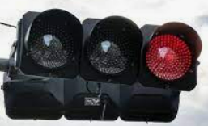
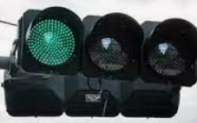


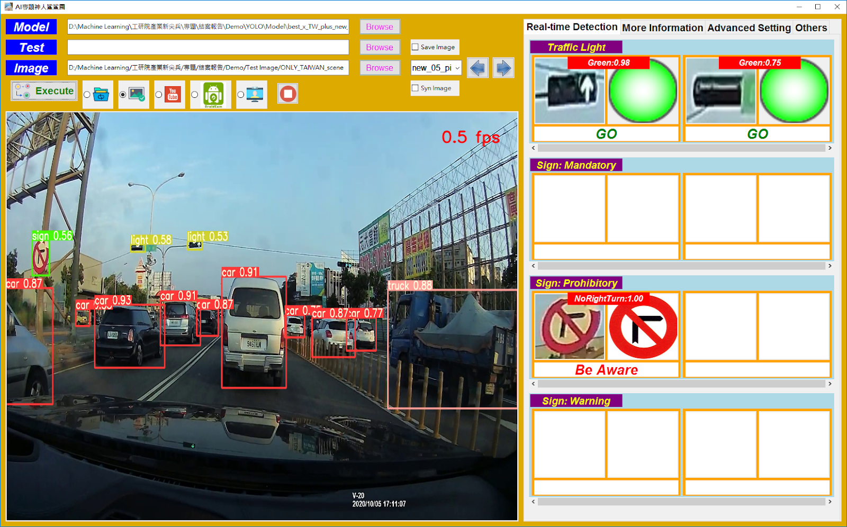
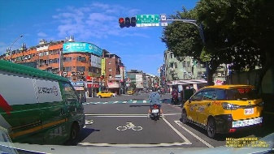
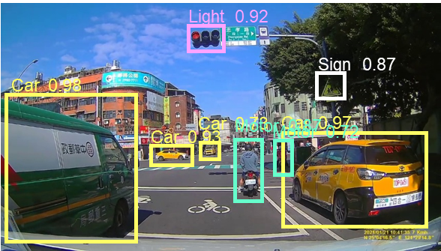


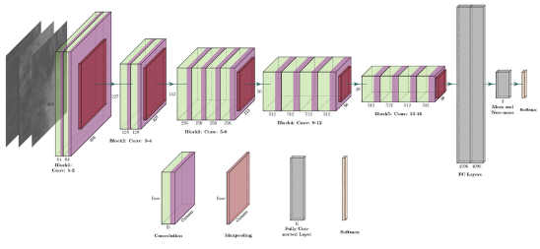









Flowchart
ML model - SVM
Traffic light classification
Flowchart
Yolov5
GUI
DashCam record
Road narrows
No right turn
Roundabout
…
Pedestrians
Speed limit
Keep left
Classification of 45 Traffic signs

Slide 12
GUI TKinter

Slide 14
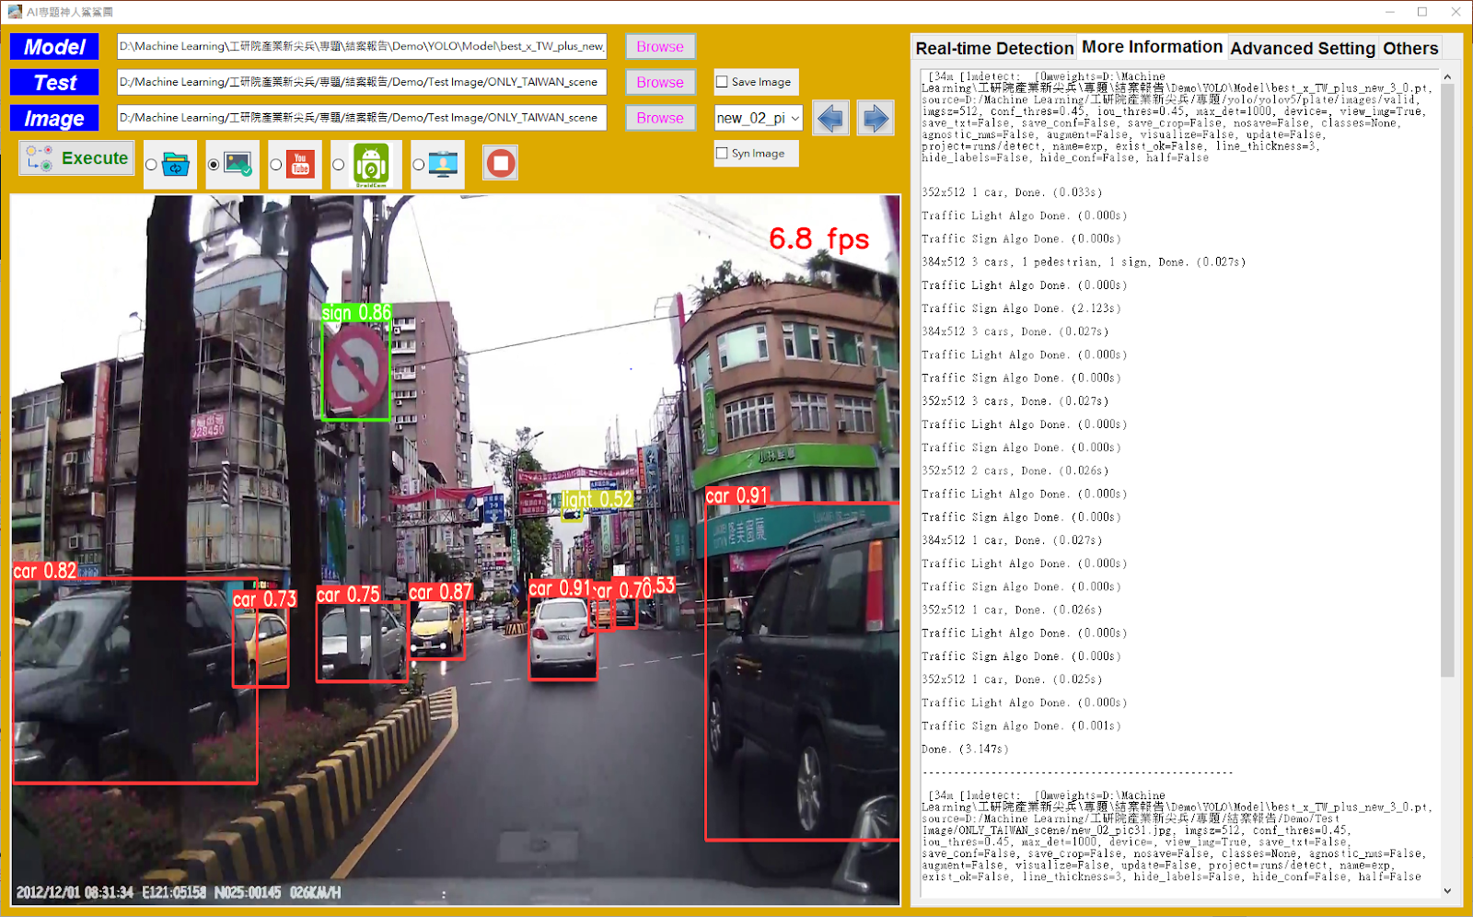

Slide 15
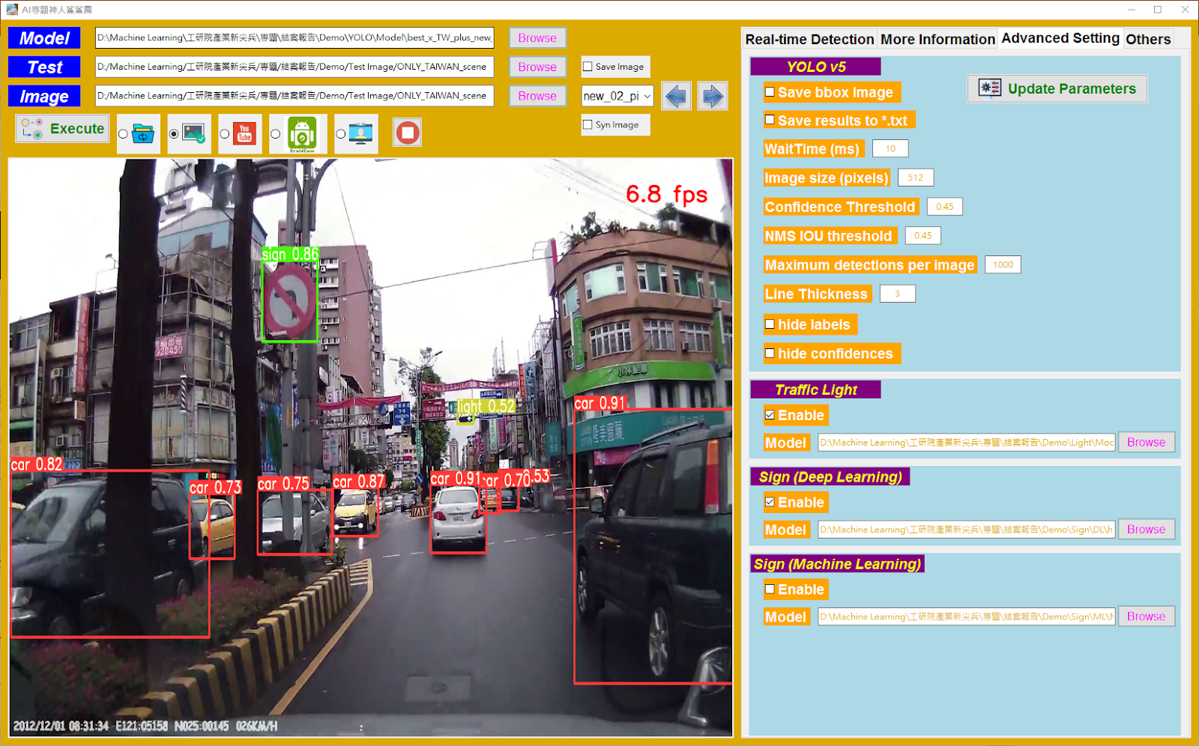

Slide 16
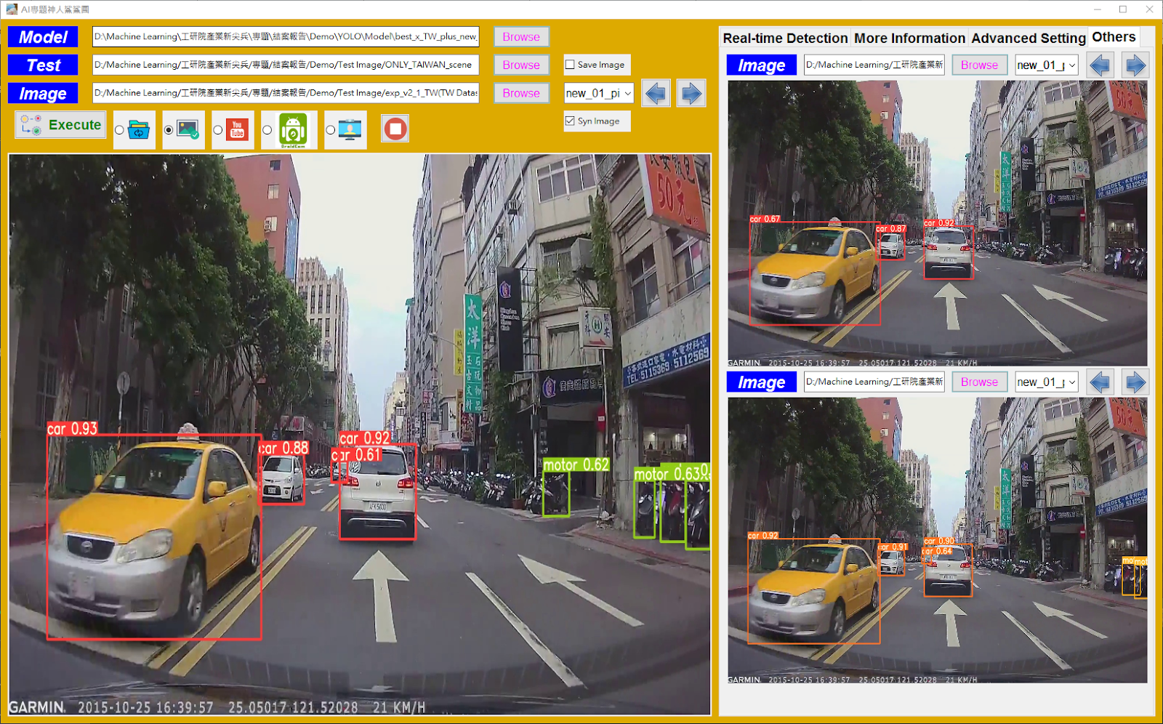

Slide 17
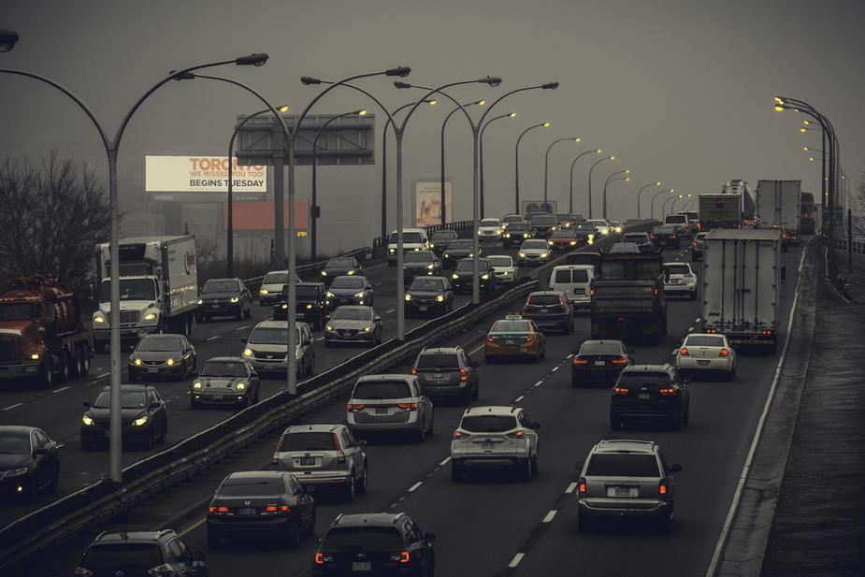
TRUCK
Object detection

Slide 18
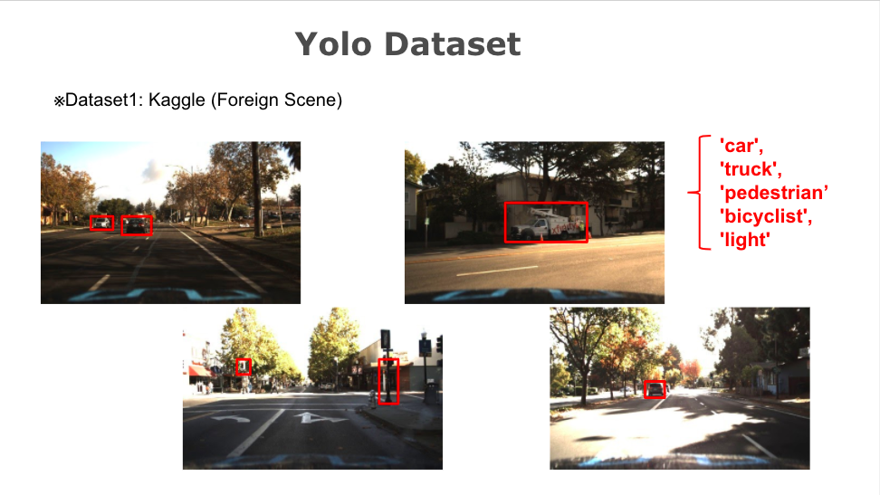

Slide 19
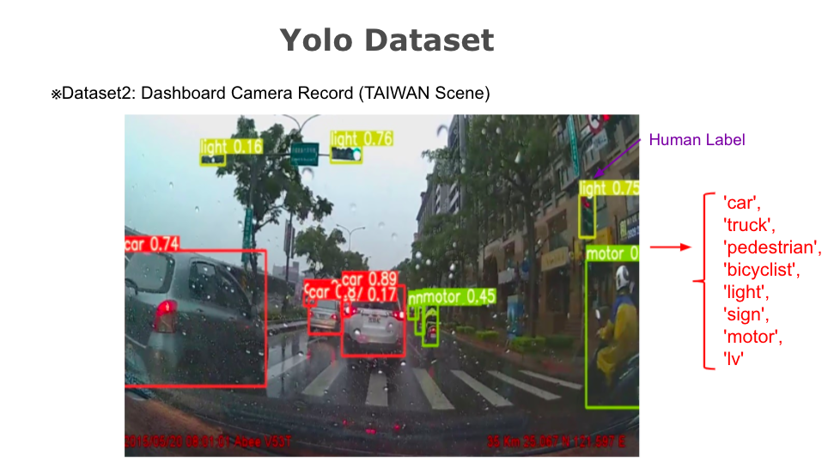

Slide 20
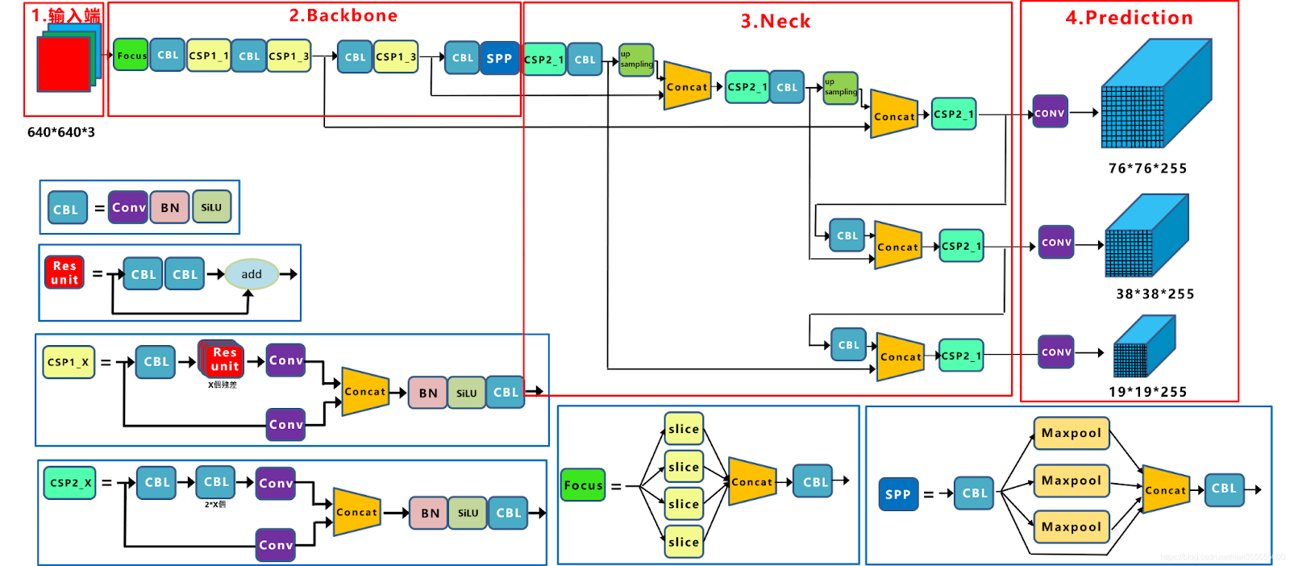
Yolov5 Principle
Detect Different Object Size
Small Object
Grid Count
Large Object
3 * (5 + 80) = 255

Slide 21
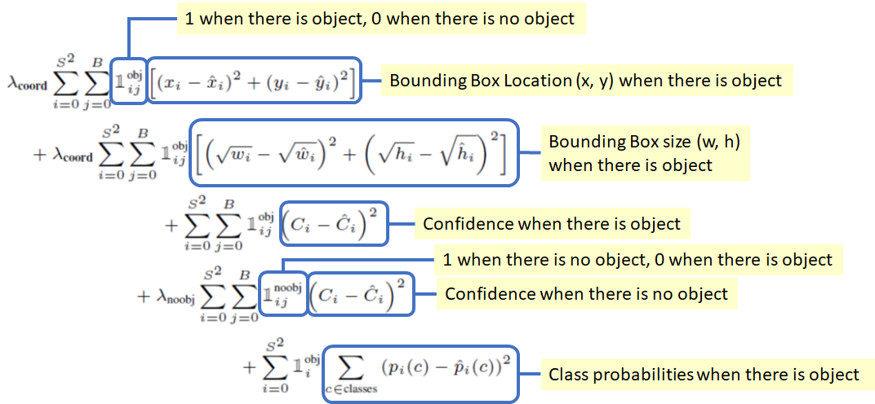
Yolov5 Loss Function

Slide 22
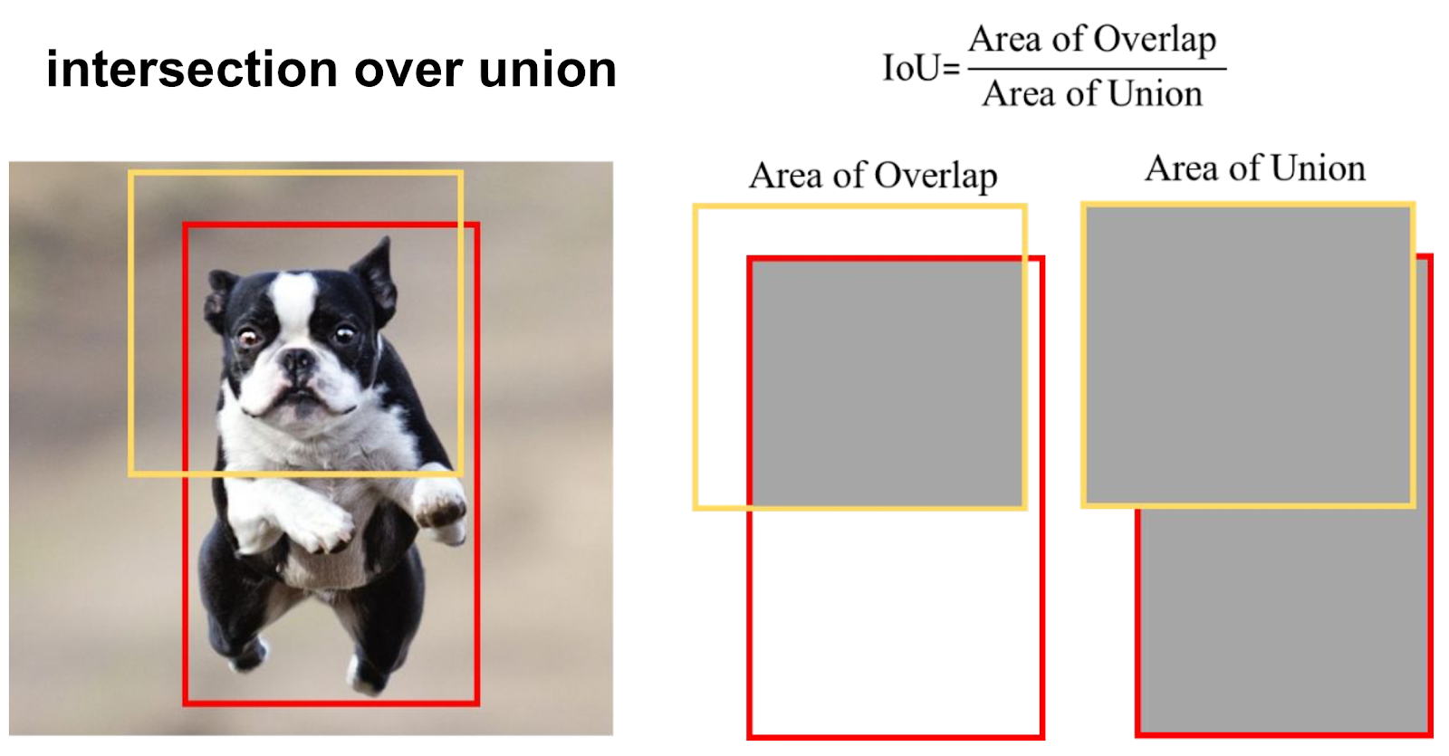
Yolov5 Metrics

Slide 23
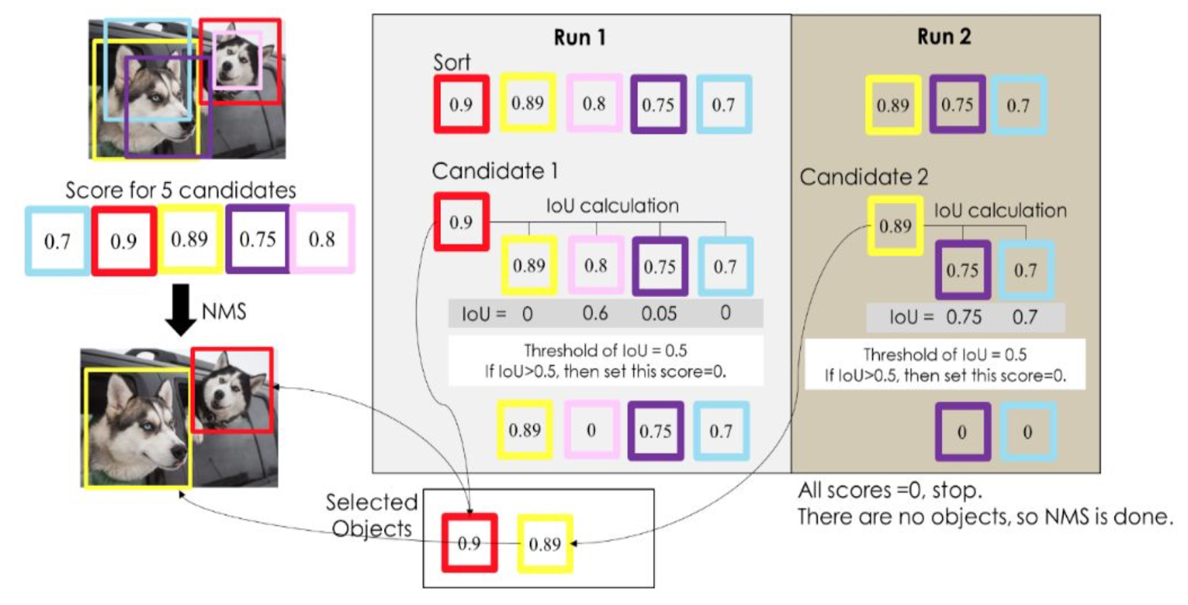
Non-maximum Suppression (NMS)

Slide 24
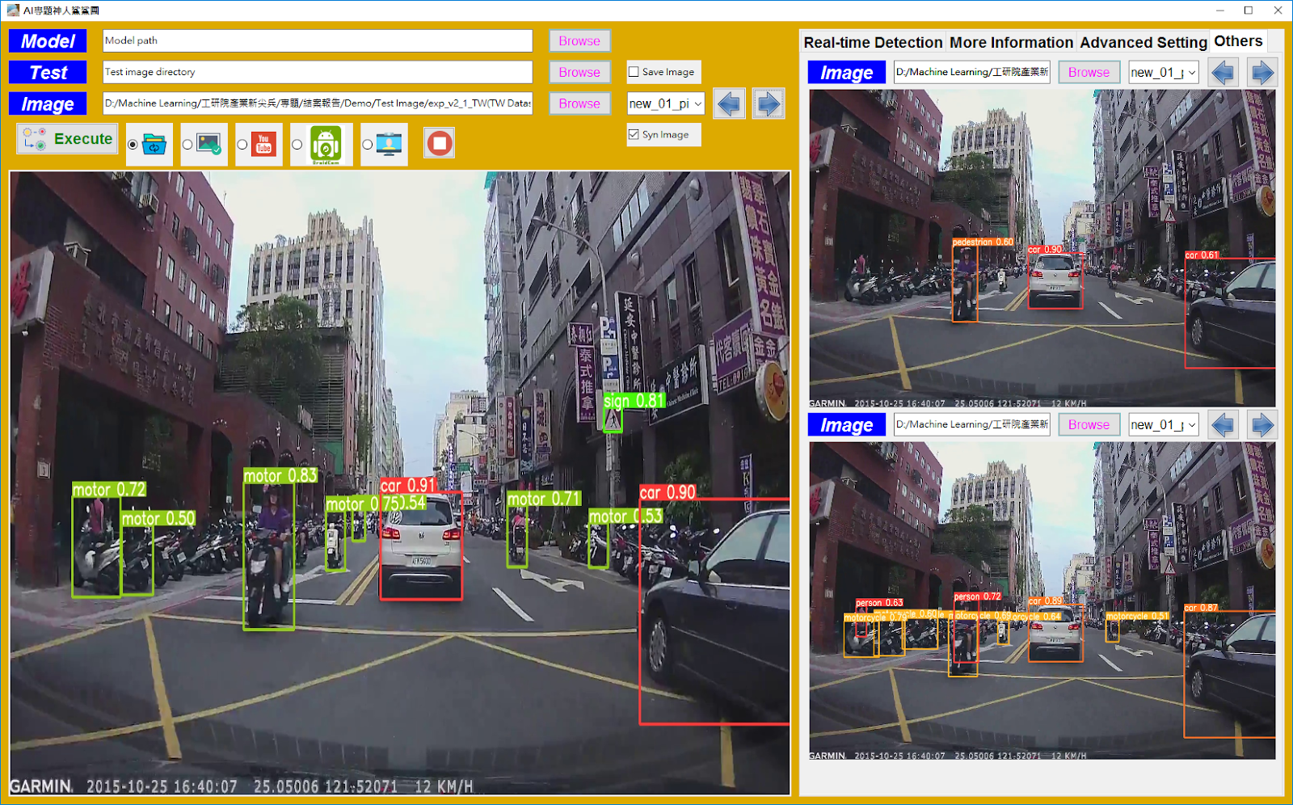
YOLOV5 Test Result (Different Dataset)
Kaggle Dataset
Add TW Dataset
COCO Dataset

Slide 25
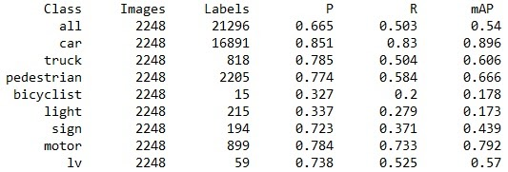
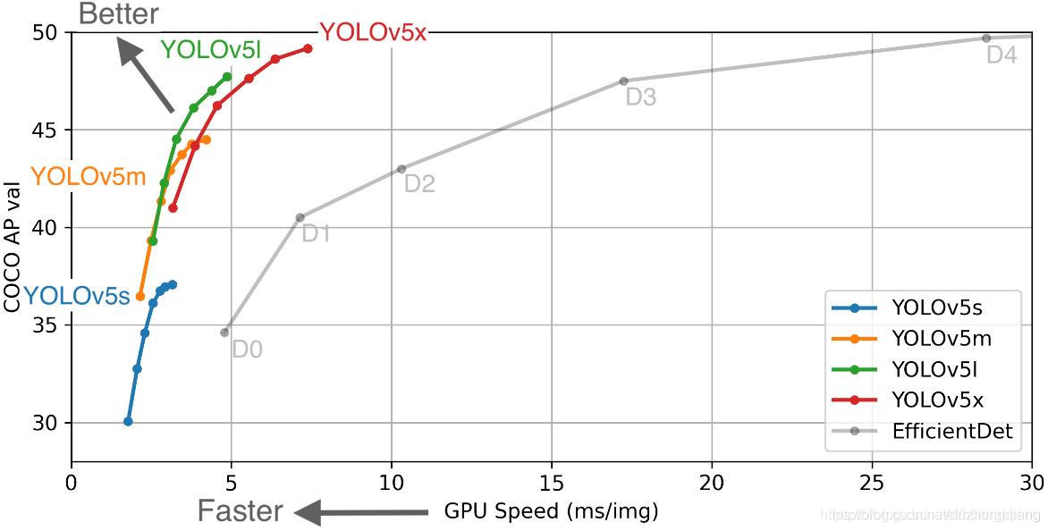
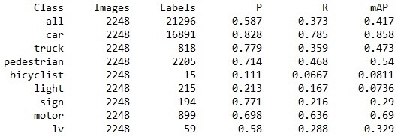
YOLOV5 Test Result (Different Model)
Hardware Specification: NVIDIA GeForce GTX 1080 Ti, 11264.0MB
YOLOv5x: 27 fps
YOLOv5m: 40 fps
YOLOv5s: 50 fps

Slide 26
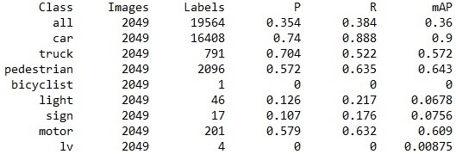
YOLOV5 Test Result (Different Hyperparameter)
YOLOv5x
YOLOv5x (more image augmentation)

Slide 27

Traffic Light Classification

Slide 28
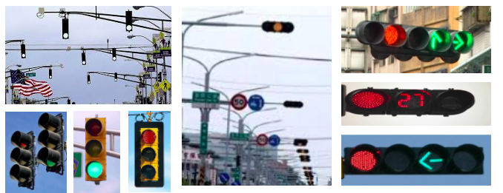
Traffic Light Dataset

Slide 29
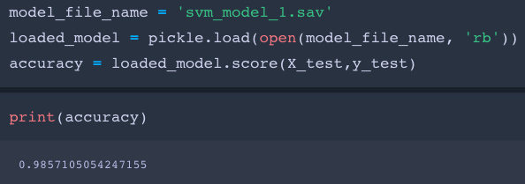
Machine Learning Model
Support Vector Machines
Logistic Regression
Random Forests
Decision Tree

Slide 30
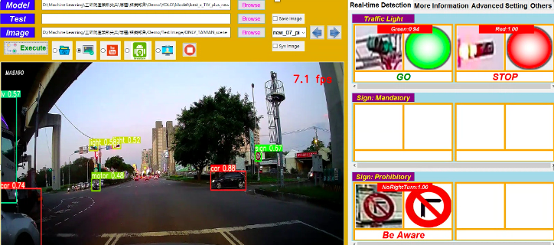
Train & Test Result
Green: 0.94 Red:1.0

Slide 31
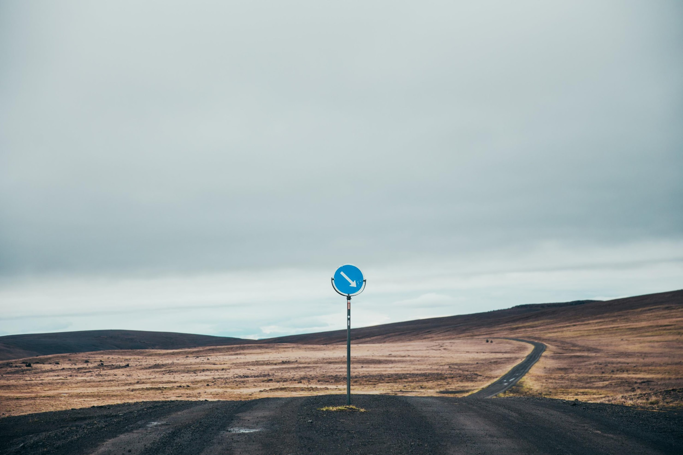
Traffic Light Recognition
Traffic Signs
Classification

Slide 32

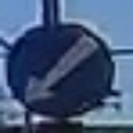

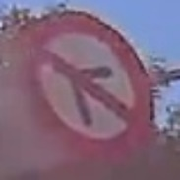
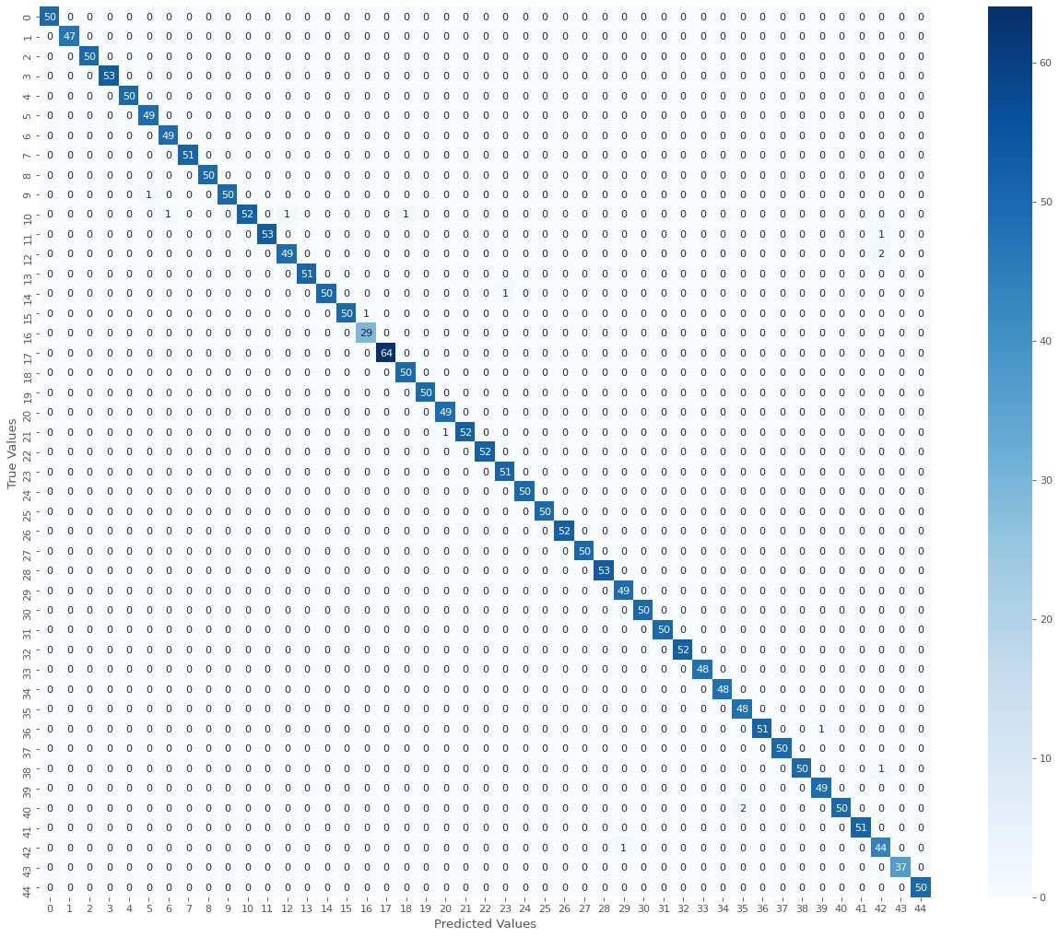
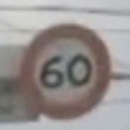
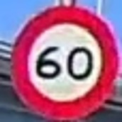

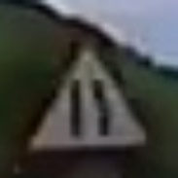
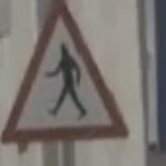
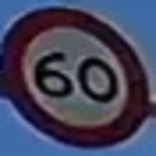
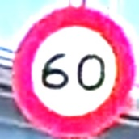
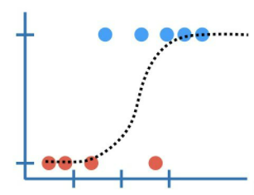

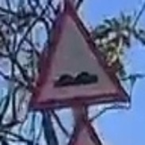
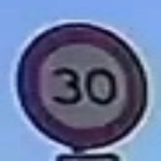
Workflow of traffic sign recognition
Data collection
Data Pre-processing
Model training & hyperparameter tuning
Test data prediction
Deep Learning model:
CNN, VGG19, ResNet50
Expanding the training data set using OpenCV and GAN.
Collecting 45 categories of foreign and Taiwan traffic signs.
The heatmap of predicting test set of 45 categories in Taiwanese signs
Machine Learning model:
Logistic Regression, SVM, Decision tree
Notes:
除了紅綠燈之外, 交通標示也是對對行車安全很重要的指標。我們將從45種台灣交通標示資料的蒐集到分別以ML, DL的model training, 最後結果可達90%以上準確率

Slide 33
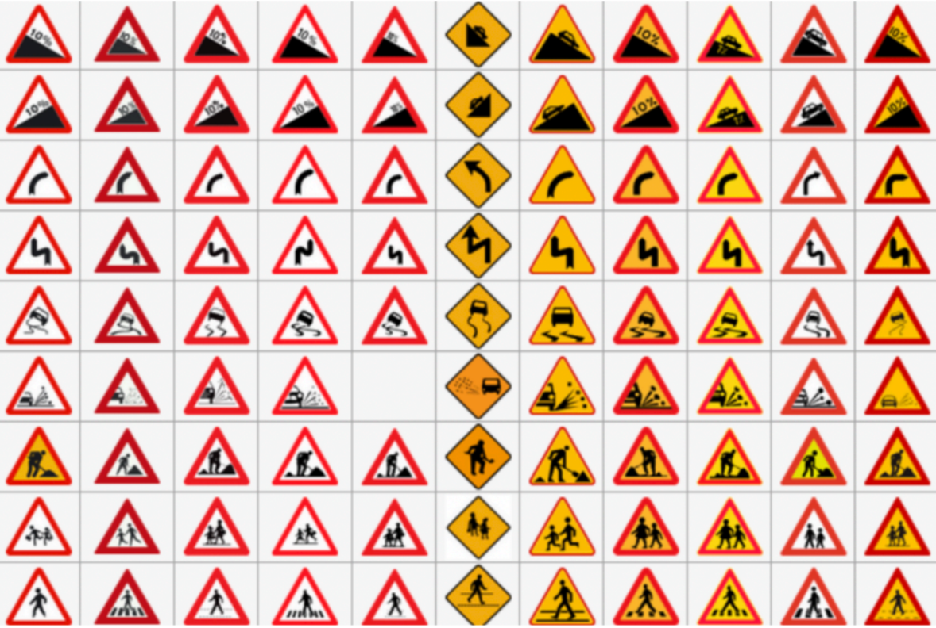
Traffic Signs Dataset
European traffic signs
Notes:
在資料蒐集的過程中, 我們遇到的第一個困境是現有的資源大部分為國外的交通標示。然而, 可以看到如圖光是歐洲各國間的交通標示就有極大差異了。實際訓練時也遭遇到國外data在訓練完model後, 在台灣場景測試的準確率極低的問題, 因此我們決定蒐集屬於我們自己的datasets。

Slide 34
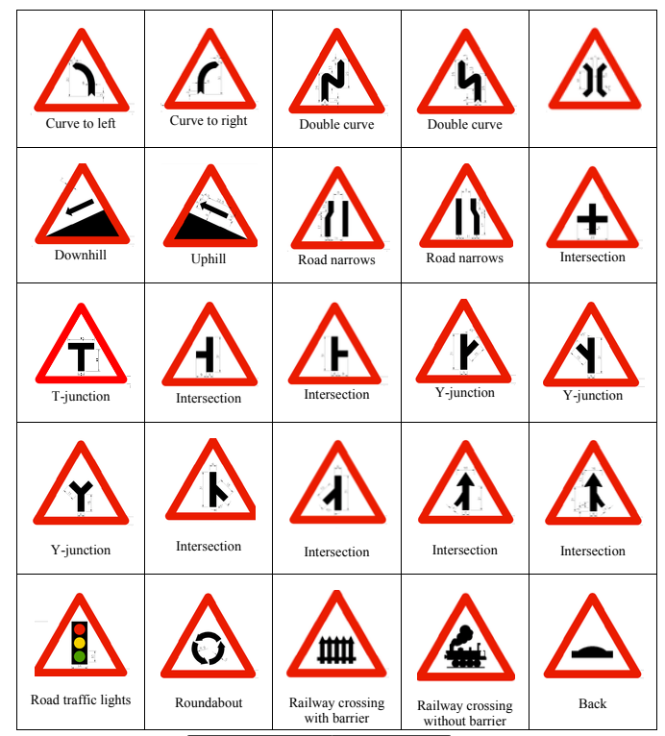
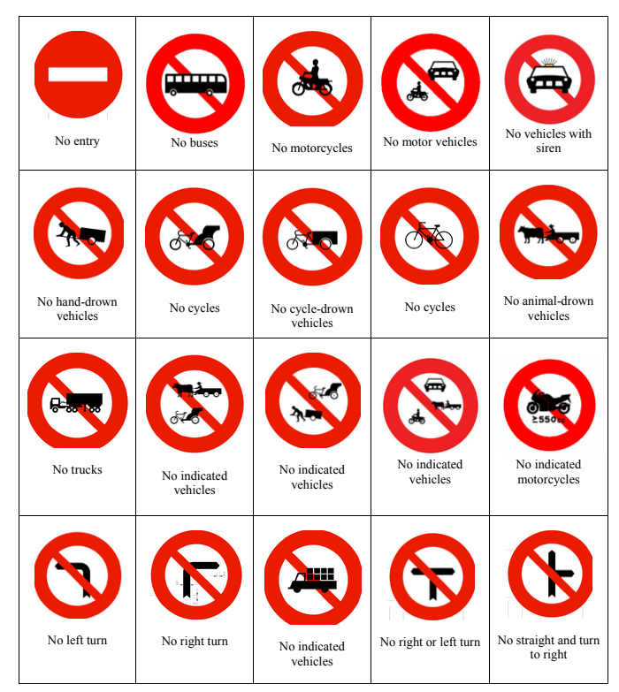
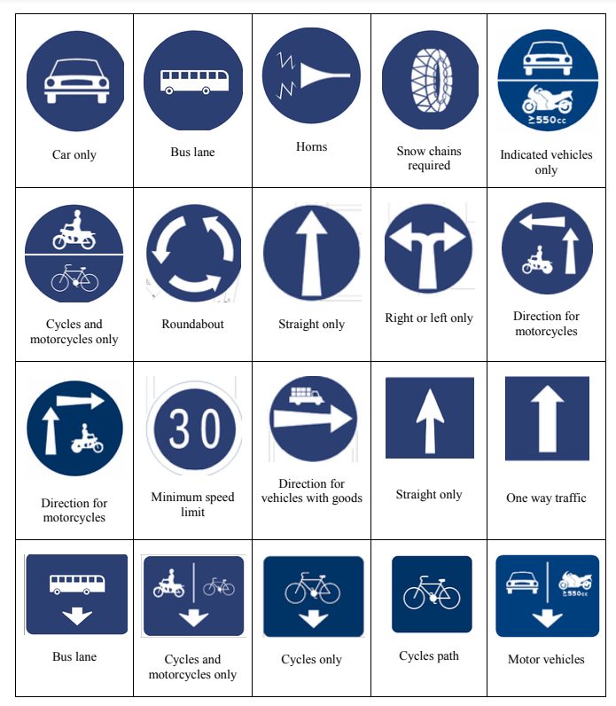
Traffic Signs Dataset
Taiwan Signs
Warning Signs
Prohibitory Signs
Mandatory Signs
Notes:
台灣的交通標誌可以大致分為三個種類: 最左邊的警告標誌, 中間的禁止通行標誌以及最右邊遵循方向指示。

Slide 35
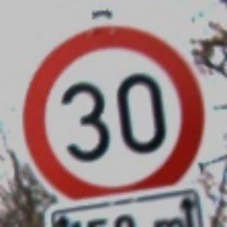
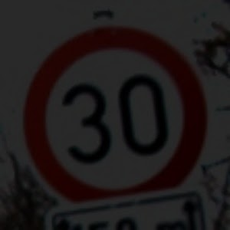
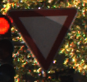
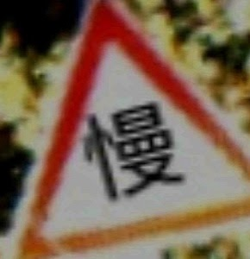
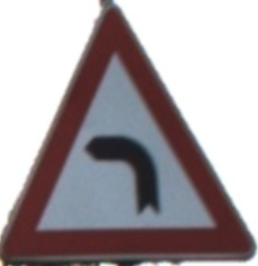
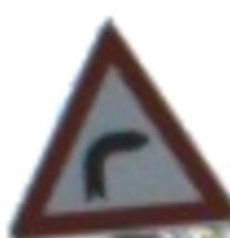
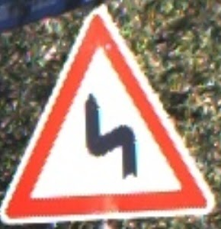
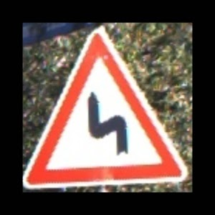




Expanding datasets with OpenCV
Problems : the amount of data between each categories are unbalanced.
Workaround : use openCV and GAN to create data.
Brightness
Over turn and add word
Over Turn
zoom in & zoom out
Perspective
Blurred
Notes:
蒐集台灣場景後, 我們所面臨的第二個問題是不同標誌出現頻率不同, 每個種類間的數目差距太大為了平均資料,我們利用opencv 新增調整明亮度 焦距調整 模糊化的照片以擴充資料集。

Slide 36



Expanding datasets with GAN
Notes:
除此之外, 我們也使用由生成器模型以及真圖假圖二元分類判別模型兩個model組成的GAN產生全新的資料進行擴充。

Slide 37

Common Traffic Signs in Taiwan
45 Categories
N = 5537 (4254+1283)
Mandatory Signs Including 10 different signs(keep right, straight only, etc)
Prohibitory Signs Including 16 different signs(no entry, speed limit, etc)
Warning Signs Including 15 different signs(stop, slow, etc)
Y : count X : category
Notes:
最終我們完成了45個種類 , 每個種類至少都含有100張圖片以上的台灣交通標示資料集。圖中是我們每個種類數量分布的統計資料。

Slide 38
Modeling in two Strategies
Machine
Learning
Deep
Learning
Methods
KNN
Logistic Regression
SVM(linear, rbg, poly, sigmoid)
Decision Tree
Random Forests
Adaboost
Notes:
一般圖像分析會想到Deep Learning 的 CNN
由於「交通號誌」的圖像單純，因此我們也嘗試用「耗費資源更少、跑程式速度更快的Machine Learning）

Slide 39
Interactive Experiment of
Data preprocessing and Training Model
Comparison of data preprocessing methods
No matter what models, using RGB and Grayscale to train model the accuracy values are stable, and the standard deviation is <0.02.
Using split RGB channel, split HSV channel, and EqualizeHist, that has similar experiment outcome.
Regardless of the model, using Canny this pretreatment is the worst.
Notes:
首先，我們交互比較「各種圖像前處理」以及「Models」
在「圖像前處理的部分」我們可以觀察到「彩色圖和灰階圖」不論放入哪種Models，它的準確度較穩定，且標準差也小於0.02
此外，我們也觀察到：如果做「輪廓特徵擷取」放入各Models準確率不穩定外，且大幅下降

Slide 40
Interactive Experiment of
Data preprocessing and Training Model
Comparing training models methods
85%
75%
The accuracy of training is around
The accuracy of training is around
Logistic Regression, SVM(linear), and Random Forests, that has similar results.
SVM(rbg, poly, sigmoid), KNN, Decision Tree, and Adaboost, that has similar results.
Notes:
在「圖像前處理」以及「Models」的交互比較中
觀察各種Models的準確率，可以明顯看到「 Logistic Regression, SVM-linear, Random」有比較好的表現，分布在85%的準確率
接著，我們使用這「三種模型」去做優化，並且嘗試「找新的特徵值」加入Models來提高準確率

Slide 41



Add New Features
Color: 80% of colors can be distinguished by using openCV.
Shape: It is difficult to find a parameter that can capture all the shape features of picture due to the large differences in focal length in pictures.
After the process, we also find that background is important for recognition.
Notes:
觀察圖像後，我們嘗試將「顏色、形狀」獨立出來成為一個特徵值
在「顏色」的特徵擷取，我們可以達到至少80%的顏色分辨率
在「形狀」的特徵擷取，由左至右，我們可以明顯看到「交通號誌在圖片中的焦距不同」，因此難以設定「參數值」
在找到新的特徵值後，我們分別「加入顏色特徵值、調整焦距」再次訓練模型，
觀察到「顏色特徵值對於Model的影響力不顯著」、「焦距較遠的圖片有較高的準確率，也因此得到背景的對比，在此分類模型訓練中是關鍵的要素」

Slide 42
Comparison of the Models
The Best Model:：Logistic Regression
Model | Accuracy | Std | Speed/sec | Testing
 |  |  |  | Foreign | Taiwan
Logistic Regression | 0.81 | 0.01 | 0.001 | 0.55 | 0.40
SVM - Linear | 0.85 | 0.01 | 0.060 | 0.32 | 0.20
Notes:
最後，比較兩個表現最好的模型「Logistic Regression, SVM-linear」
這兩個模型顯示出，「交通號誌的分類」分析是具有線性關係的
然而，從「Testing」我們可以明顯看出「SVM的多維度訓練方式」造成了更嚴重的overfitting
未來，我們會針對Logistic Regression overfitting的問題進行改善，來提升辨識的泛化性

Slide 43
Modeling in two Strategies
Machine
Learning
Deep
Learning
Methods
based on Simplified-CNN
based on VGG 19,
based on ResNet 50

Slide 44








Simplified-CNN_v1 Construct
Input Image
(32x32)
Training Accuracy | Testing
 | Foreign | Taiwan
0.8682 | 0.6338 | 0.4583
45 categories
….
0
0
…
0
1

Slide 45
Simplified-CNN_v1 Construct
Input Image
(32x32)
Change | Model | Testing
 |  | Foreign | Taiwan
- | SCNN_v1 | 0.6338 | 0.4583
v1 add Convolution & Max Pooling | SCNN_v2 | 0.8419 | 0.6458
v2 add Batch Normalization | SCNN_v3 | 0.8458 | 0.6562
v3 reduce dense number | SCNN_v4 | 0.7388 | 0.5364
v3 add Dense layer | SCNN_v5 | 0.8387 | 0.5677
v3 add Dropout | SCNN_v6 | 0.7420 | 0.5729
v3 change activation function | SCNN_v7 | 0.8281 | 0.5833
v3 Convolution Kernel size | SCNN_v8 | 0.7852 | 0.7031
v3 add Convolution | SCNN_v9 | 0.7810 | 0.6770
45 categories
….
0
0
…
0
1

Slide 46

VGG19-based Construct
45 categories
1
0
. . .
. . .
Input Image
(32x32)
0
0
VGG19: Full
Training Accuracy | Testing
 | Foreign | Taiwan
0.1748 | 0.2332 | 0.1718

Slide 47

VGG19-based Construct
Model | Training Accuracy | Testing
 |  | Foreign | Taiwan
VGG19: Full | 0.1748 | 0.2332 | 0.1718
VGG19: Block4 | 0.9621 | 0.8473 | 0.7187
VGG19: Block3 | 0.9786 | 0.9091 | 0.8958
VGG19: Block2 | 0.9933 | 0.9051 | 0.7864
VGG19: Block1 | 0.9862 | 0.6338 | 0.4583
Schematic diagram

Slide 48

ResNet50-based Construct
45 categories
1
Input Image
(32x32)
0
Model | Training Accuracy | Testing
 |  | Foreign | Taiwan
ResNet50 | 0.9848 | 0.8128 | 0.6875
ResNet50_v2 (conv2) | 0.9915 | 0.8836 | 0.7083
. . .
. . .
0
0

Slide 49
ResNet50-based Construct
45 categories
1
Input Image
(32x32)
0
Model | Training Accuracy | Testing
 |  | Foreign | Taiwan
ResNet50 | 0.9848 | 0.8128 | 0.6875
ResNet50_v2 (conv2) | 0.9915 | 0.8836 | 0.7083
. . .
. . .
0
0

Slide 50


Comparison of the three Models
The Best Model:： VGG19: Block3
Notes:
最後我們依舊選擇VGG19作為我們的主要磨行

Slide 51


Comparison for ML and DL
FPS: 25
FPS:10
Model | Accuracy |  | Efficiency
 | Foreign | Taiwan | Sec
Logistic Regression | 55.5% | 39.16% | 0.001
SVM - Linear | 32.25% | 19% | 0.001
Model | Accuracy |  | Efficiency
 | Foreign | Taiwan | Sec
VGG19 | 90.91% | 89.58% | 0.113
ResNet | 88.37% | 70.83% | 0.200
Simplified - CNN | 84.58% | 65.63% | 0.088
Notes:
結論是，ML的速度優於DL，但DL的準確度優於ML

Slide 52
QA

Slide 53
Thanks.

